Slide 1



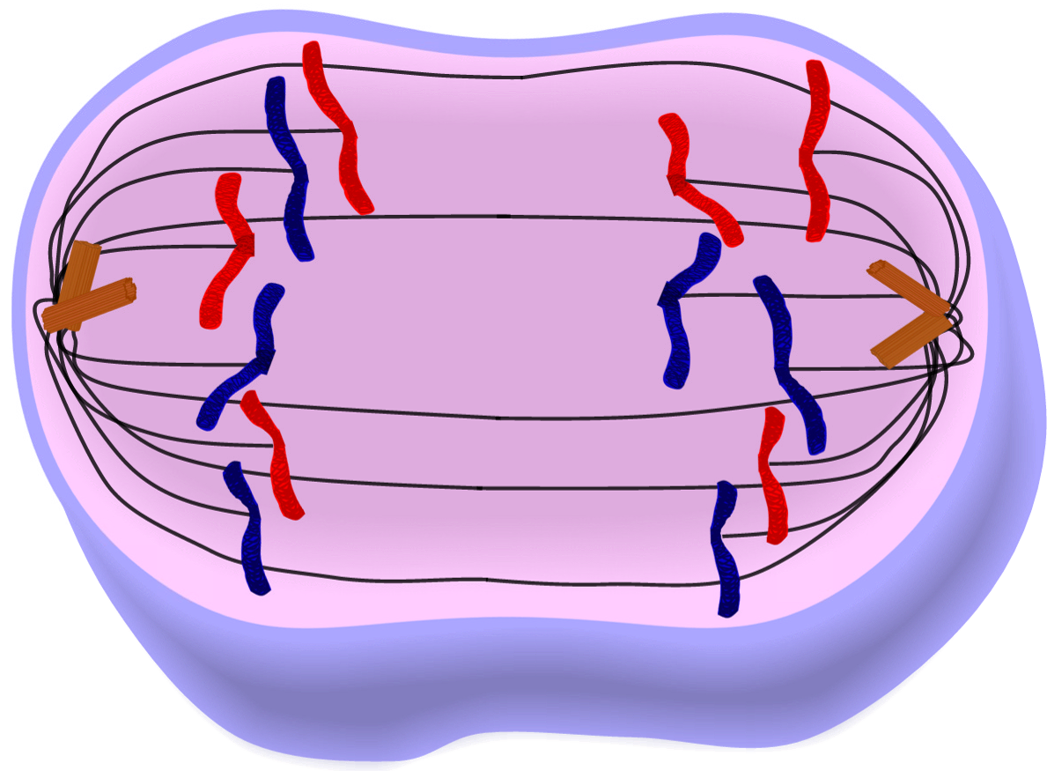





Mitosis/Meiosis Choice Project Name ____________________
Choose one of the projects listed below to demonstrate your understanding of mitosis and meiosis. Include the different stages in each type of cell division. Compare and contrast the similarities and differences between mitosis and meiosis.
Infographic
Video Lesson
Model
Song
Scrapbook
Lesson Plan
Prezi
Student Choice

Slide 2

Mitosis/Meiosis Choice Project Name ____________________
Choose one of the projects listed below to demonstrate your understanding of mitosis and meiosis. Include the different stages in each type of cell division. Compare and contrast the similarities and differences between mitosis and meiosis.
Infographic – Create a bulletin board for your classroom. Include the different stages in each type of cell division. Compare and contrast the similarities and differences between mitosis and meiosis.
Song – Write a song or rap that includes the different stages in each type of cell division. Compare and contrast the similarities and differences between mitosis and meiosis.
Scrapbook – Create a scrapbook that includes the different stages in each type of cell division. Compare and contrast the similarities and differences between mitosis and meiosis.
Prezi – Create a Prezi to present to your class. Include the different stages in each type of cell division. Compare and contrast the similarities and differences between mitosis and meiosis.
Teach a lesson – Design a lesson for a 5th grade class. Include in your lesson the different stages in each type of cell division. Compare and contrast the similarities and differences between mitosis and meiosis.
Video – Create a video to demonstrate the different stages in each type of cell division. Compare and contrast the similarities and differences between mitosis and meiosis.
Model – Build a model to show the different stages in each type of cell division. Compare and contrast the similarities and differences between mitosis and meiosis.
Student Choice – Present your idea to the teacher for approval. Must demonstrate your understanding of the different stages in each type of cell division. Compare and contrast the similarities and differences between mitosis and meiosis.

